Slide 1
minimum spanning trees
CS340

Slide 2
Minimum Spanning Tree
Given connected graph G with positive edge weights, find a minimum weight set of edges that connects all of the vertices.

Slide 3
Examples
Use the least amount of wire to connect a set of pins on a circuit board
Use the least amount of road to connect every house in a town
Lease the fewest phone lines to connect different offices

Slide 4
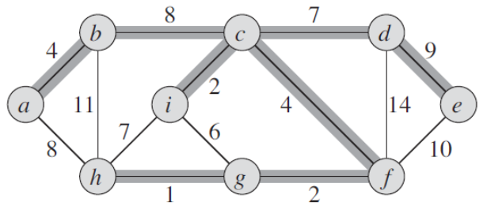
Properties of MST
|V| - 1 edges (it's a tree)
It has no cycles
If an edge causes a cycle, lower the cost by removing it
It might not be unique
remove (b,c) and replace with (a,h)

Slide 5
Growing a MST
Greedy method
Maintain a set of edges A, such that
Prior to each iteration, A is a subset of some minimum spanning tree.
At each step, determine an edge (u,v) that can be added to A without violating this invariant
A ∪ {(u,v)} is also a subset of a minimum spanning tree.
Such an edge is called a safe edge

Slide 6
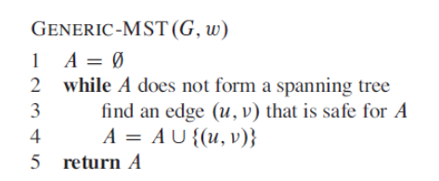
Generic MST

Slide 7
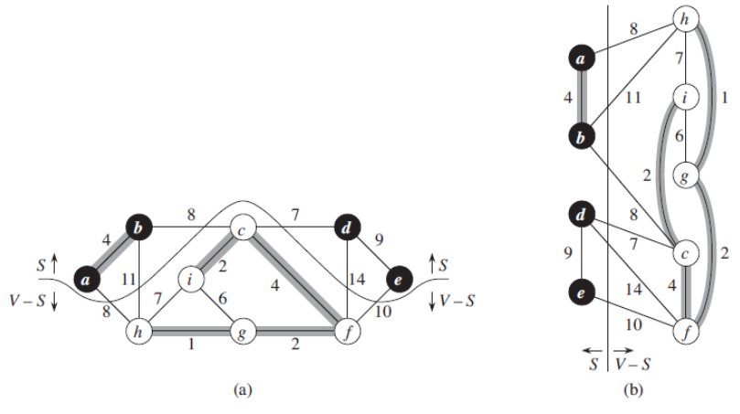
Definitions
A cut (S, V-S) of an undirected graph G = (V,E) is a partition of V.
A cut respects a set A of edges if no edge in A crosses the cut.
An edge is a light edge crossing a cut if its weight is the minimum of any edge crossing the cut. There can be more than 1.

Slide 8
A rule for recognizing safe edges
Let A be a subset of E that is included in some minimum
spanning tree for G
Let (S, V-S) be any cut of G that respects A
Let (u, v) be a light edge crossing (S, V-S).
Then, edge (u,v) is safe for A.

Slide 9
Interview Questions
Must the minimum weight edge in a graph be part of a minimum spanning tree?
Show that a graph has a unique minimum spanning tree if, for every cut of the graph, there is a unique light edge crossing the cut (if each edge-weight is unique). Show that the converse is not true by giving a counterexample.
continued →

Slide 10
Interview Questions
Let G be an undirected connected graph with distinct edge weight. Let emax be the edge with maximum weight and emin the edge with minimum weight. Which of the following statements is false?
Every minimum spanning tree of G must contain emin
If emax is in a minimum spanning tree, then its removal must disconnect G
No minimum spanning tree contains emax
G has a unique minimum spanning tree

Slide 11
Kruskal's Algorithm
Uses disjoint sets
The set A is a forest whose vertices are all those of the given graph.
Kruskal’s algorithm finds a safe edge to add to the growing forest by finding, of all the edges that connect any two trees in the forest, an edge (u,v) of least weight.
Qualifies as a greedy algorithm because at each step it adds to the forest an edge of least possible weight.

Slide 12
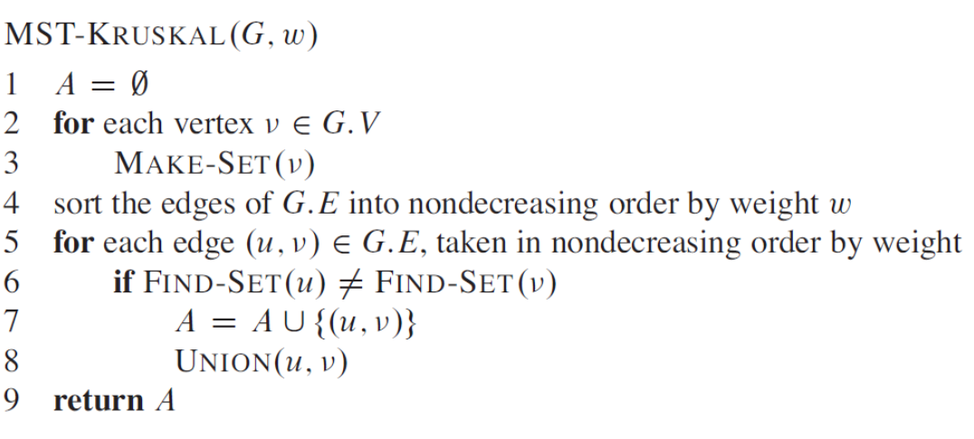
Kruskal's Algorithm

Slide 13
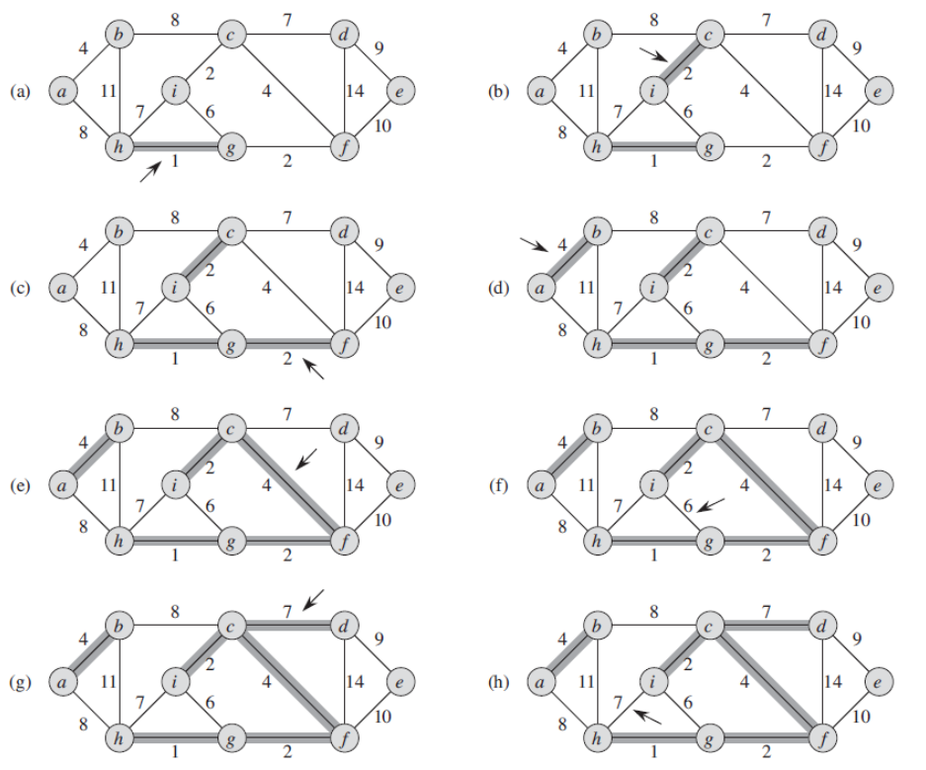
Kruskal
Considers edges in order of weight
Edge is added if its two ends are parts of different trees

Slide 14
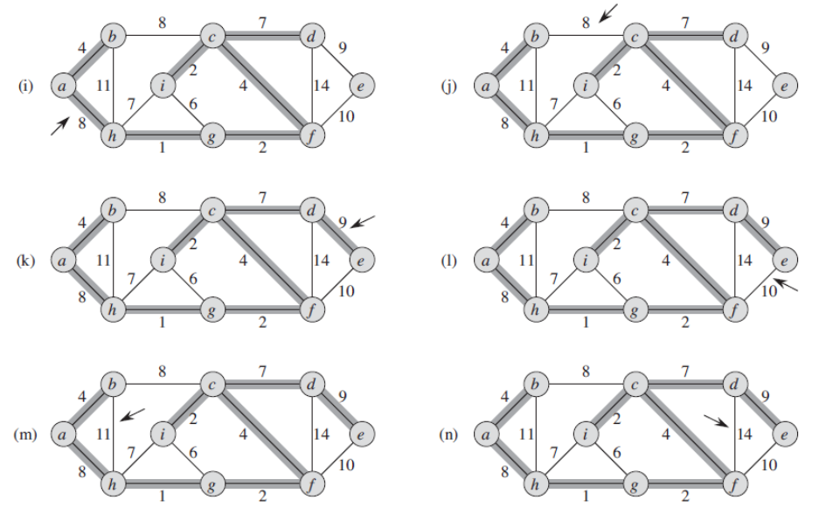

Slide 15
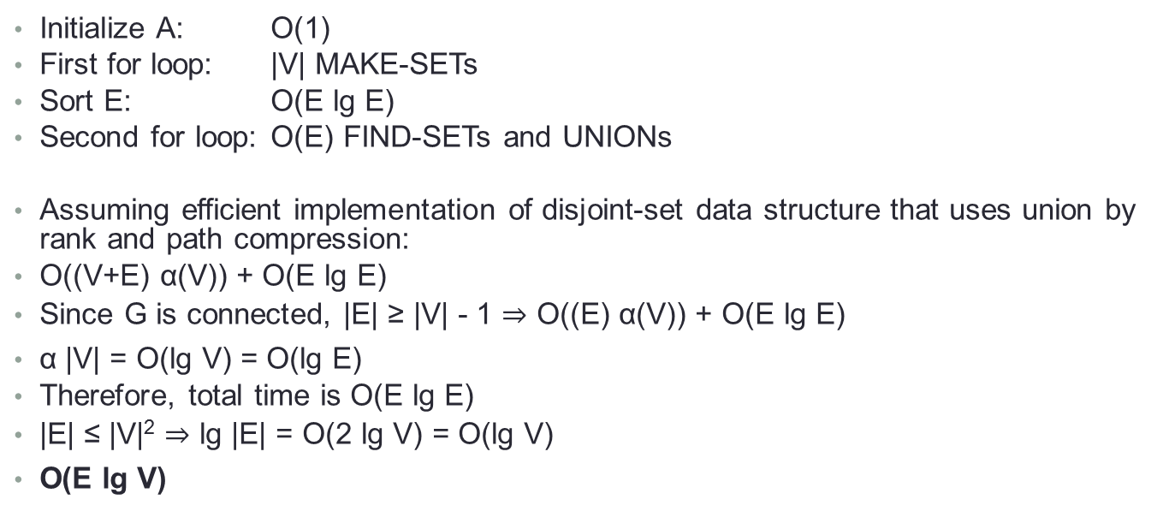
Kruskal Complexity
Initialize A: O(1)
First for loop: |V| MAKE-SETs
Sort E: O(E lg E)
Second for loop: O(E) FIND-SETs and UNIONs
Assuming efficient implementation of disjoint-set data structure that uses union by rank and path compression:
O((V+E) α(V)) + O(E lg E)
Since G is connected, |E| ≥ |V| - 1 O((E) α(V)) + O(E lg E)
α |V| = O(lg V) = O(lg E)
Therefore, total time is O(E lg E)
|E| ≤ |V|² lg |E| = O(2 lg V) = O(lg V)
O(E lg V)

Slide 16
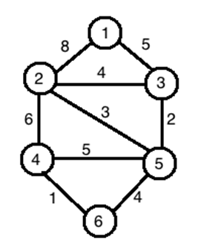
Interview Questions
Run Kruskal's algorithm on this graph.

Slide 17
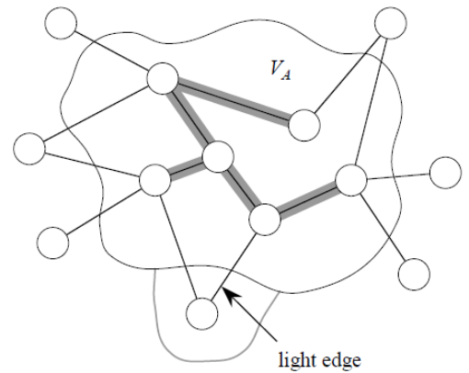
Prim's Algorithm
Builds one tree, so A is always a tree.
Starts from an arbitrary “root” r.
At each step, find a light edge crossing cut (V_{A}, V-V_{A}), where V_{A} = vertices that A is incident on. Add this edge to A.

Slide 18
Prim's Algorithm
How to find the lightest edge quickly? Use a priority queue:
Each object is a vertex in V - V_{A}.
Key of is minimum weight of any edge (u,v) where u ∈ V_{A}.
Then the vertex returned by EXTRACT-MIN is v such that there exists u ∈ VA and (u,v) is light edge crossing (V_{A}, V-V_{A}/.
Key of v is ∞ if v is not adjacent to any vertices in V_{A}.

Slide 19
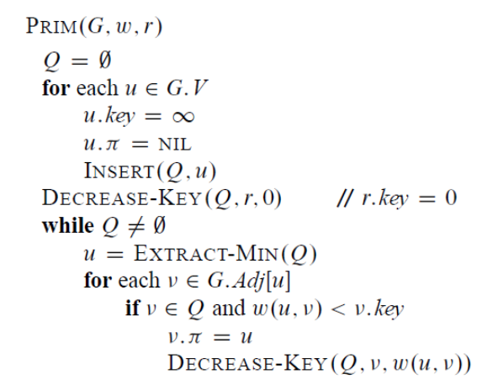
Prim's Algorithm

Slide 20
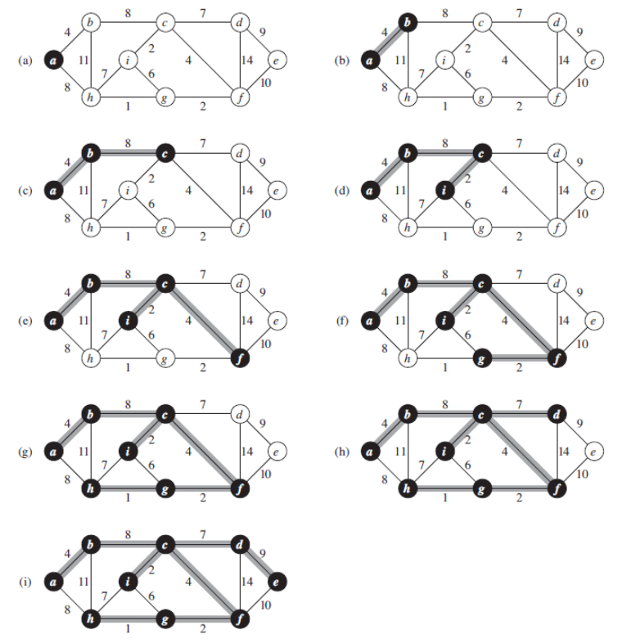
Prim's Algorithm

Slide 21
Prim Efficiency
Suppose Q is a binary heap.
Initialize Q and first for loop: O(V lg V)
Decrease key of r: O(lg V)
while loop: |V| EXTRACT-MIN calls = O(V lg V) ≥ |E| DECREASE-KEY calls = O(E lg V)
Total: O(E lg V)

Slide 22

Interview Questions
Run Prim's algorithm on this graph.
Suppose that we represent the graph G = (V,E) as an adjacency matrix. Give a simple implementation of Prim’s algorithm for this case that runs in O(V²) time.
Let G be a weighted graph with edge weights greater than one and G' be the graph constructed by squaring the weights of edges in G. How is MST of G different from MST of G'?
How about if G' is G with 5 added to each edge?

Slide 23
Interview Questions
T/F The minimum weight edge on any cut is always part of the MST.
Let G be a connected undirected graph of 100 vertices and 300 edges. The weight of a minimum spanning tree of G is 500. When the weight of each edge of G is increased by five, what is the weight of a minimum spanning tree?
Suppose we have an undirected graph with weights that can be either positive or negative. Do Prim’s and Kruskal’s algorithim produce a MST for such a graph?

Slide 24
Interview Questions
Can Prim and/or Kruskal be used to find a maximum spanning tree?

